Slide 1
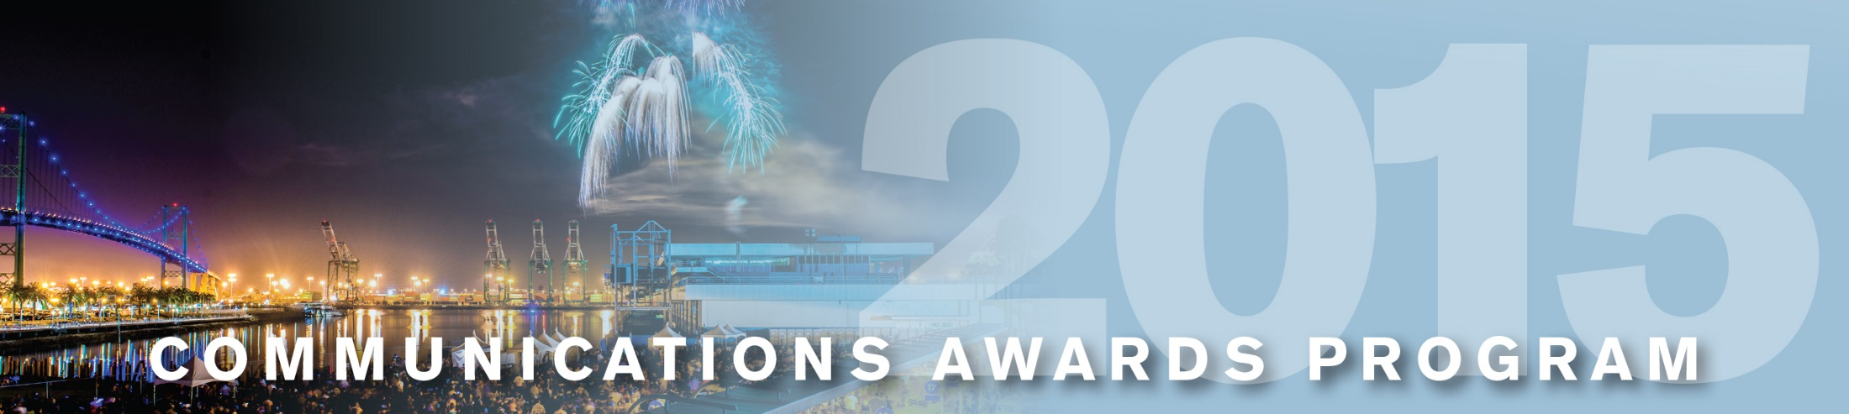
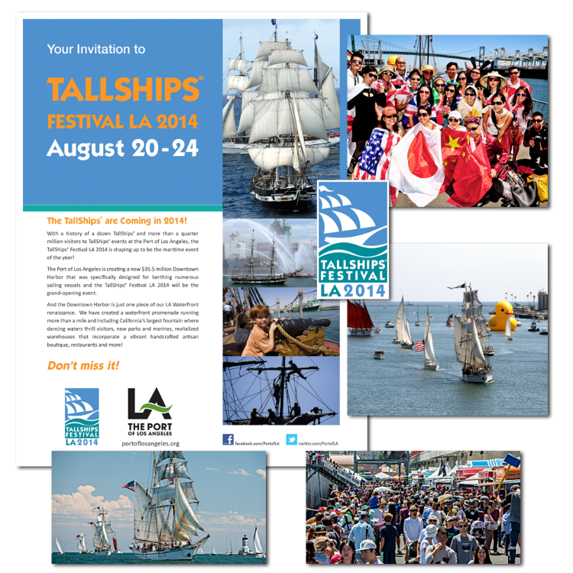
Port of
Los Angeles
Tall Ships Festival LA 2014
Special Event

